Slide 1
UDP Check sum Problem

Slide 2
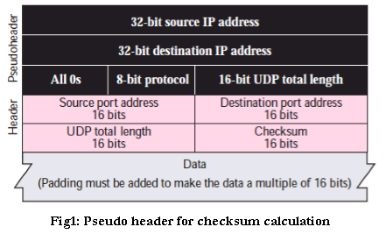

Slide 3
UDP Checksum calculation is similar to TCP Checksum computation.
It’s also a 16-bit field of one’s complement of one’s complement sum of a pseudo UDP header + UDP datagram.

Slide 4
Sender Side
It treats segment contents as sequence of 16-bit integers.
All segments are added. Let's call it sum.
Checksum: 1's complement of sum.(In 1's complement all 0s are converted into 1s and all 1s are converted into 0s).
Sender puts this checksum value in UDP checksum field.

Slide 5
Receiver Side
Calculate checksum
All segments are added and then sum is added with sender's checksum.
Check that any 0 bit is presented in checksum. If receiver side checksum contains any 0 then error is detected. So the packet is discarded by receiver.

Slide 6
Problem 1
0110011001100110 0110011001100110 0000111100001111:
This bit stream is divided into segments of 16-bits integers.
So, it looks like this:
0110011001100110 (16-bit integer segment)
0101010101010101
0000111100001111

Slide 7
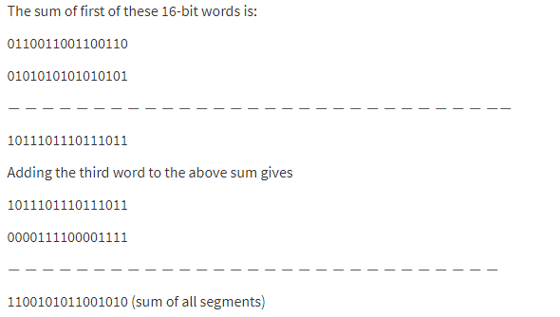

Slide 8
Now to calculate checksum 1's complement of sum is taken. As I mentioned earlier, 1's complement is achieved by converting all 1s into 0s and all 0s into 1s. So, the checksum at sender side is: 0011010100110101.
Now at the receiver side, again all segments are added .and sum is added with sender's checksum.
If no error than check of receiver would be: 1111111111111111.
If any 0 bit is presented in the header than there is an error in checksum. So, the packet is discarded.
Although UDP provides error checking, it does not do anything to recover from an error.

Slide 9
Problem-2

Slide 10
Internet checksum: example
example: add two 16-bit integers
1 1 1 1 0 0 1 1 0 0 1 1 0 0 1 1 0
1 1 1 0 1 0 1 0 1 0 1 0 1 0 1 0 1
1 1 0 1 1 1 0 1 1 1 0 1 1 1 0 1 1
1 1 0 1 1 1 0 1 1 1 0 1 1 1 1 0 0
1 0 1 0 0 0 1 0 0 0 1 0 0 0 0 1 1
wraparound
sum
checksum
Note: when adding numbers, a carryout from the most significant bit needs to be added to the result
* Check out the online interactive exercises for more examples: http://gaia.cs.umass.edu/kurose_ross/interactive/
Notes:
Kurose and Ross forgot to say anything about wrapping the carry and adding it to low order bit

Slide 11
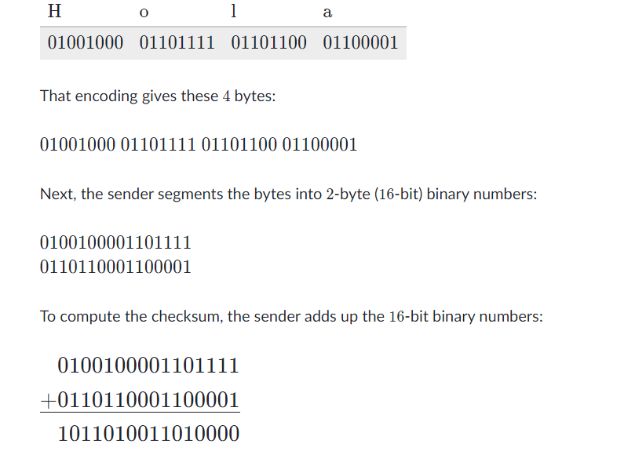
Problem-3

